Slide 1
NLP: Let the Machine Do the Reading
Pytorch

Slide 2
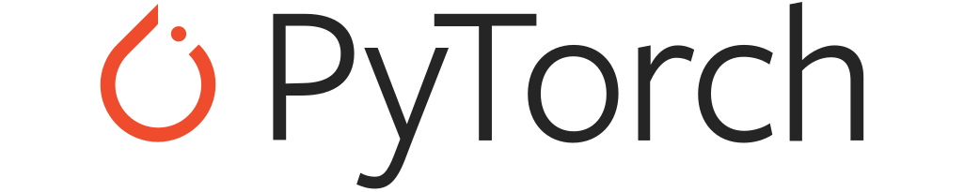
What is Pytorch?
Open source machine learning library
Developed by Facebook, based on Torch, a scientific computing framework
Specializes in tensor computations, automatic differentiation, and GPU acceleration
It is becoming the most popular deep learning library

Slide 3
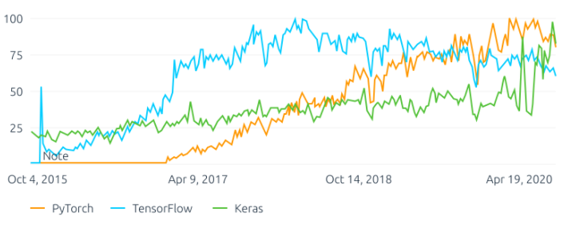
How Popular is Pytorch?

Slide 4
Pros of Pytorch
More pythonic than other libraries such as Keras or Tensorflow
Easy to extend/customise, for instance, implement custom layer types, network architecture, etc...
Makes it super easy to train neural networks, i.e. backpropagation…
Supports distributed training that can allow you to train your models even faster. It primarily supports NVIDIA CUDA-based GPUs
Furthermore, PyTorch gives deep learning practitioners complete control over the training loop
Notes:
Traverse the network backwards (i.e., backpropagation) and adjust the parameters of the network such that it (ideally) makes more accurate predictions based on the computed loss/output. Is always the most tedious and time consuming step to implement by hand. Luckily for us, PyTorch takes care of that step automatically.

